Slide 1

Walk @ Work Step Count Challenge
Results!

Slide 2
Importance of Wellness in the Workplace
Encourage adoption of healthier lifestyle to help prevent onset of illness/disease and support stress management.
Nurture a supportive and collaborative work environment to maintain productivity, motivation, and high morale.
Provide opportunities and create spaces that strengthen creativity, leadership, and engagement with one another across our units.
Live the mission of connecting, serving, and changing lives in the workplace!

Slide 3
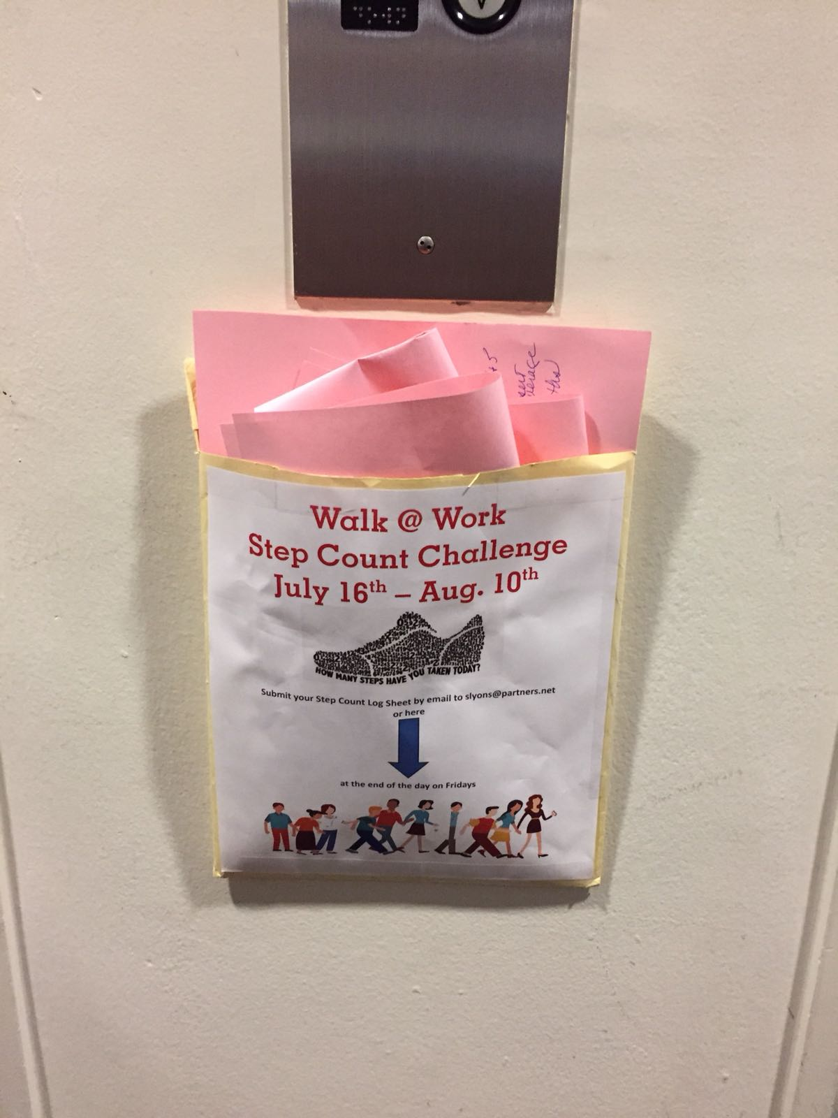
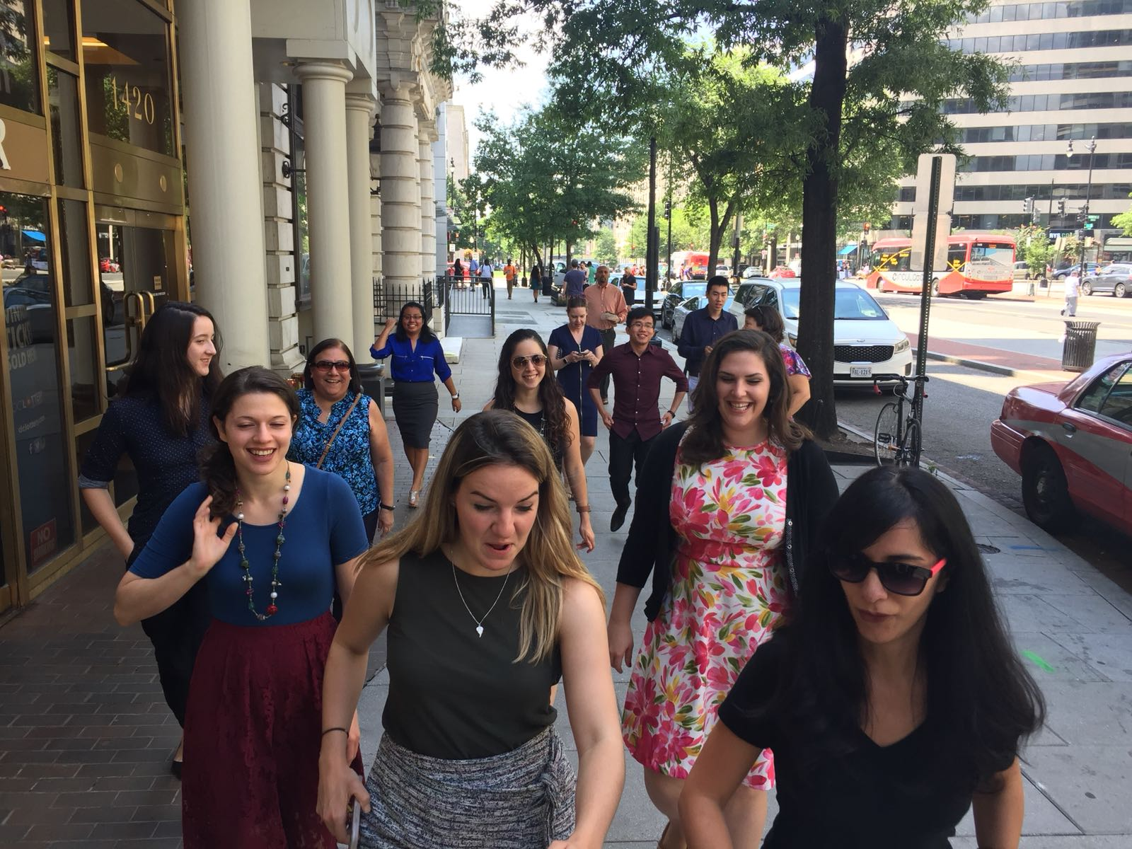
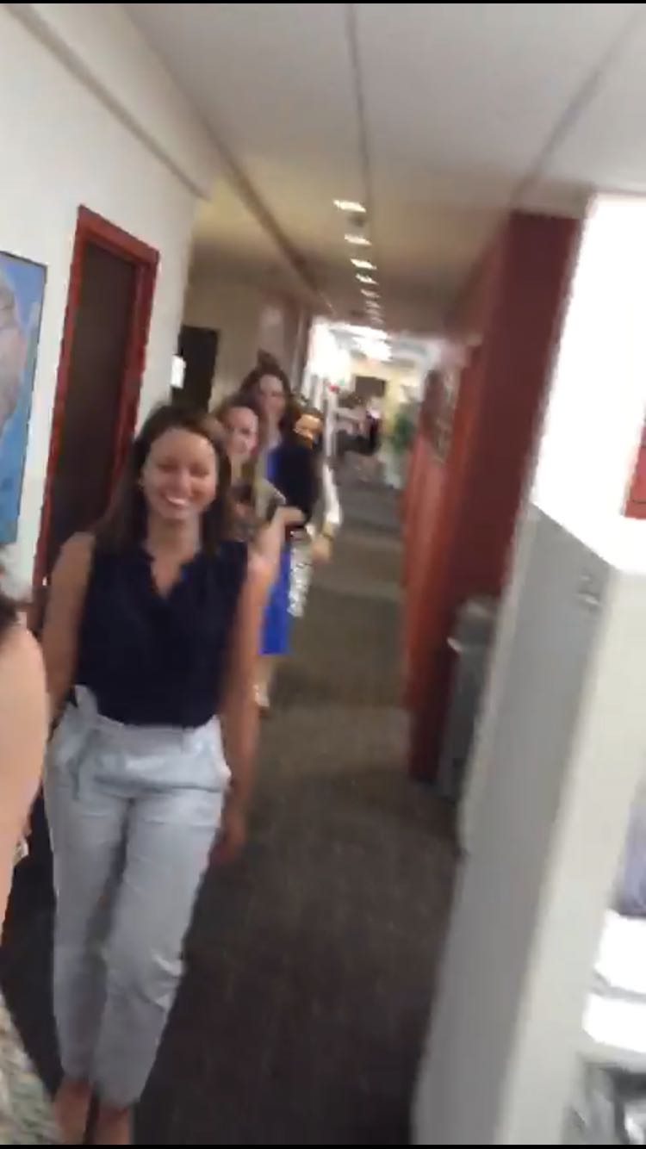
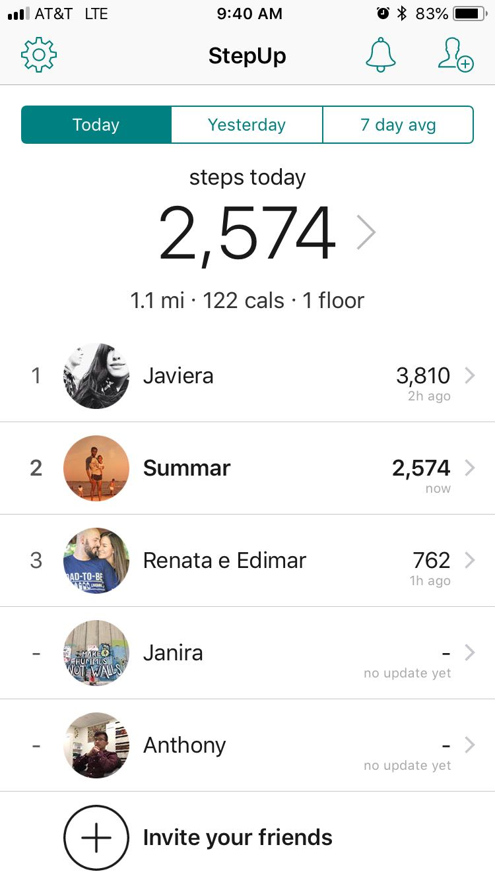
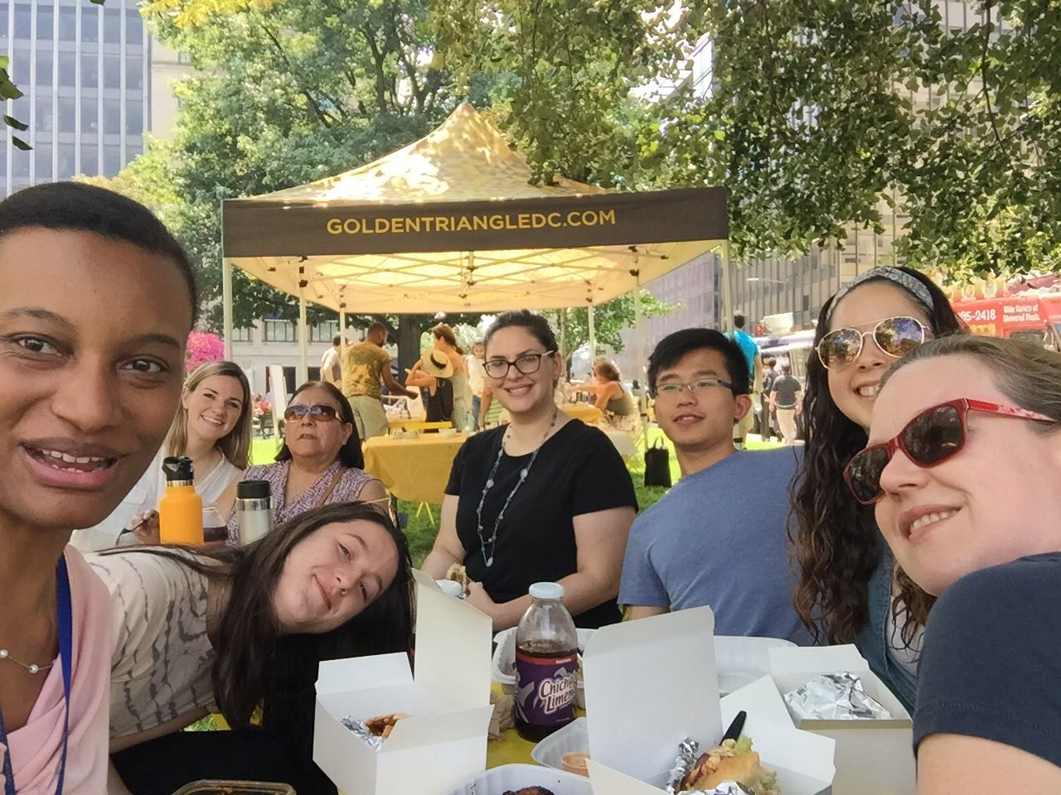

Slide 4
Week to Week Stats
Notes:
23 – 28 miles per week

Slide 5
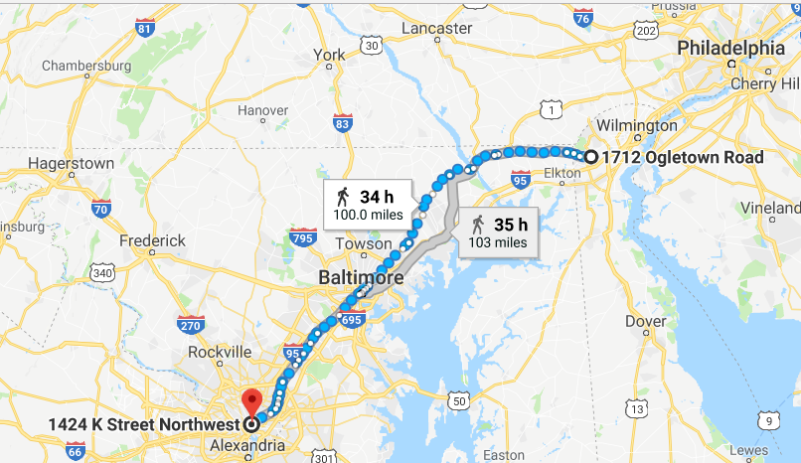
Total Number of Steps, Collectively 1,013,187 How far did our steps take us?
Approximately
101 Miles
Wilmington, DE

Slide 6
Step Count Considerations
Full Day of Sick Leave & Annual Leave
To ensure that everyone’s effort in the challenge be considered equally, your average number of steps walked for the full 4 weeks was added to the days you were out sick or on vacation to be included in the final total.
Example:
Average # of steps for 4 weeks = 1450
1450 was calculated into days on SL or AL
Wednesday W@W Step Boosters & Bonuses
Opportunity to participate in light physical activity in the middle of the week & middle of the day
5 Laps Around the Office: 500 Steps
Walk/Stop Energizer: +600 Bonus
Shoe Drop: +650 Bonus
Lap Around the Building: +650 Bonus
Farragut Friday Food Truck Lunch: +1,000 Steps Bonus

Slide 7

TEAM E
Melissa, Adriano, Clarissa & Javiera
226,795 Steps Walked
22.6 Miles
Prizes: Fitness Gear

Slide 8

Third Place
Melissa
73,905 Steps Walked
7.4 Miles
Prize: $10 Gift Card

Slide 9

Second Place
Renata
83,888 Steps Walked
8.4 Miles
Prize: $25 Gift Card to Whole Foods

Slide 10



First Place
John
114,531 Steps Walked
11.5 Miles
Prize: Groupon, 1 Month of Unlimited Yoga Classes
Notes:
Prize: Groupon for Unlimited Yoga Classes for a Month

Slide 11

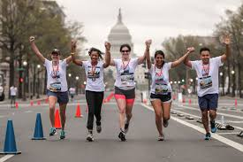
Now what? What are our next steps?
Post Survey
DC Run/Walk
Google Form
https://www.active.com/washington-dc/walking
Notes:
https://www.active.com/washington-dc/walking

Slide 12
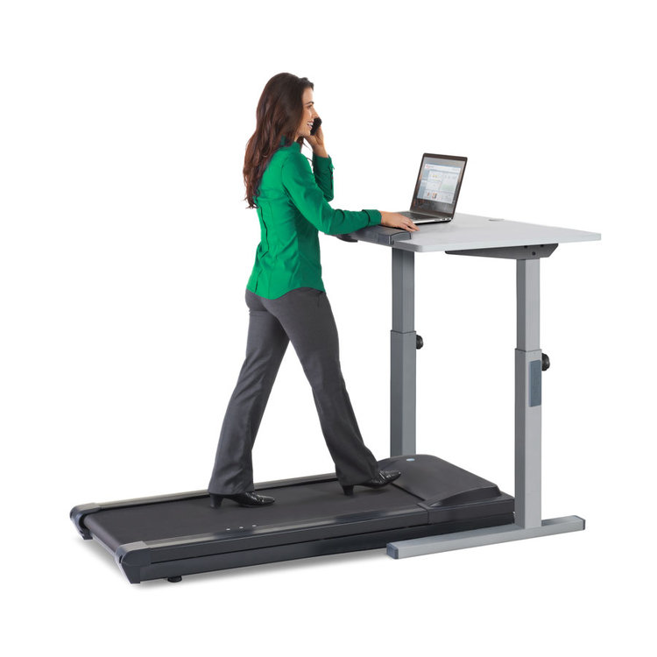
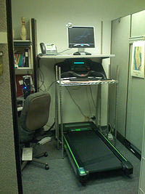
Now what? What are our next steps?
Treadmill Workstation as Wellness Benefit
Notes:
https://www.active.com/washington-dc/walking

Slide 13


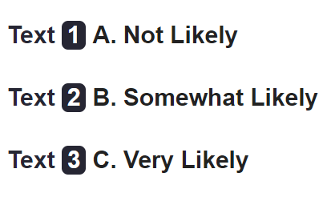
Live Text Poll
If a Treadmill Workstation were available for use in the office as a Wellness benefit to staff, how likely would you use it?
Notes:
https://www.active.com/washington-dc/walking
p.excitem.com/s/presentation/poll?eId=c99486c4a533e0d4f4413d4ed4c614de040346d7c1a363f5ec52bb7205bd23a9

Slide 14
W@W Group Photo for Social after the meeting
Gracias y Felicidades!!

